Slide 1

You Only Look One-level Feature
2021，CVPR
Author: Qiang Chen Yingming Wang Tong Yang Xiangyu Zhang
Jian Cheng Jian Sun
Chinese Academy of Sciences
MEGVII Technology
https://arxiv.org/abs/2103.09460
Reporter: 王俊杰 焦晓宁
计算机科学与工程学院
大数据与机器学习实验室

Slide 2
Content
1
Introduction
2
Method
3
Experiment

Slide 3
1
Introduction

Slide 4
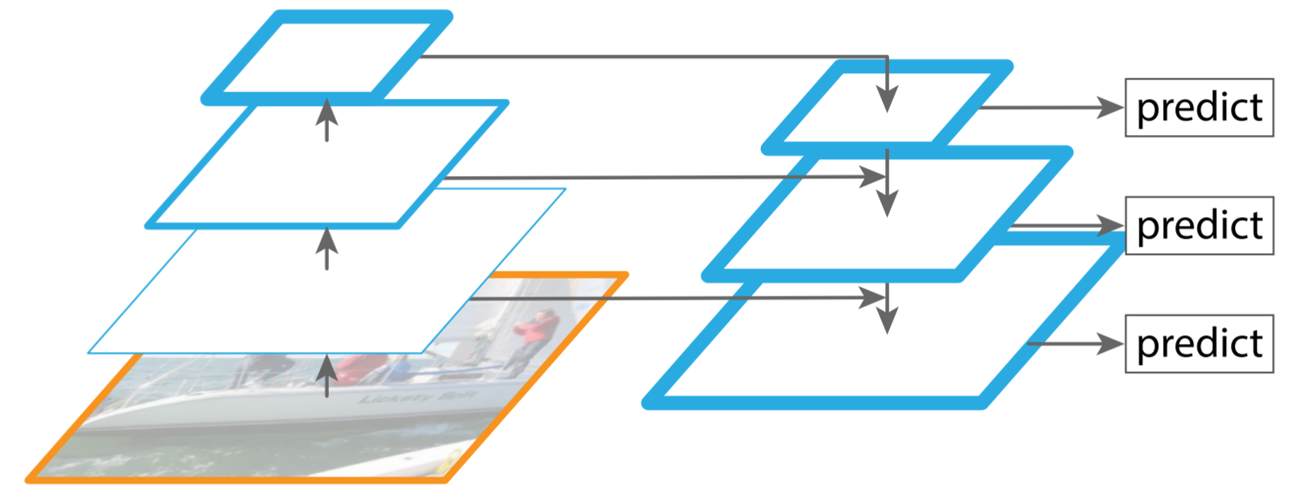
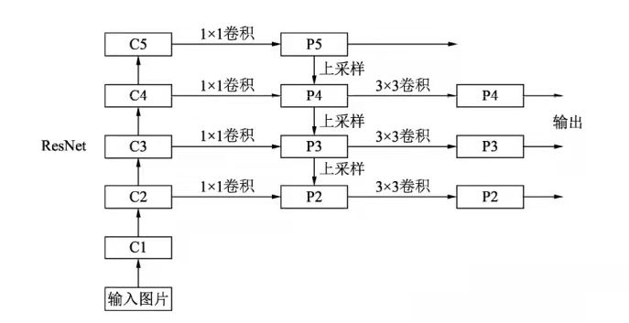
1
Introduction
Background
FPN(Feature Pyramid Network):
● multi-scale feature fusion: fusing multiple low-resolution and high- resolution feature inputs to obtain better representations;
● divide-and-conquer: detecting objects on different levels regarding objects’ scales.
Feature Pyramid Network

Slide 5
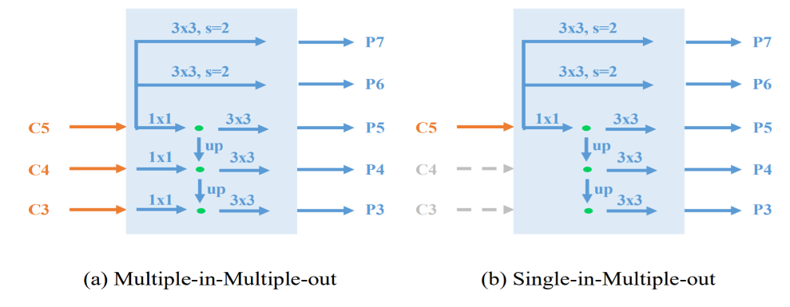
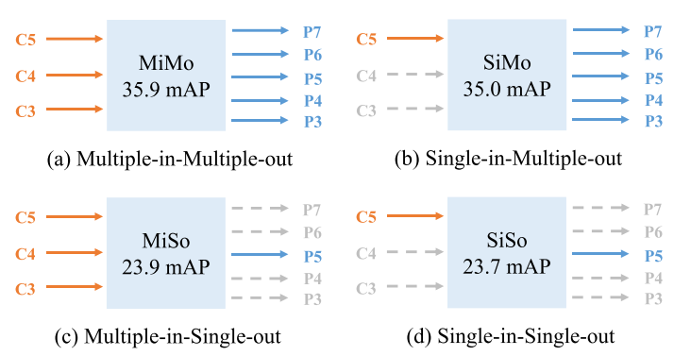
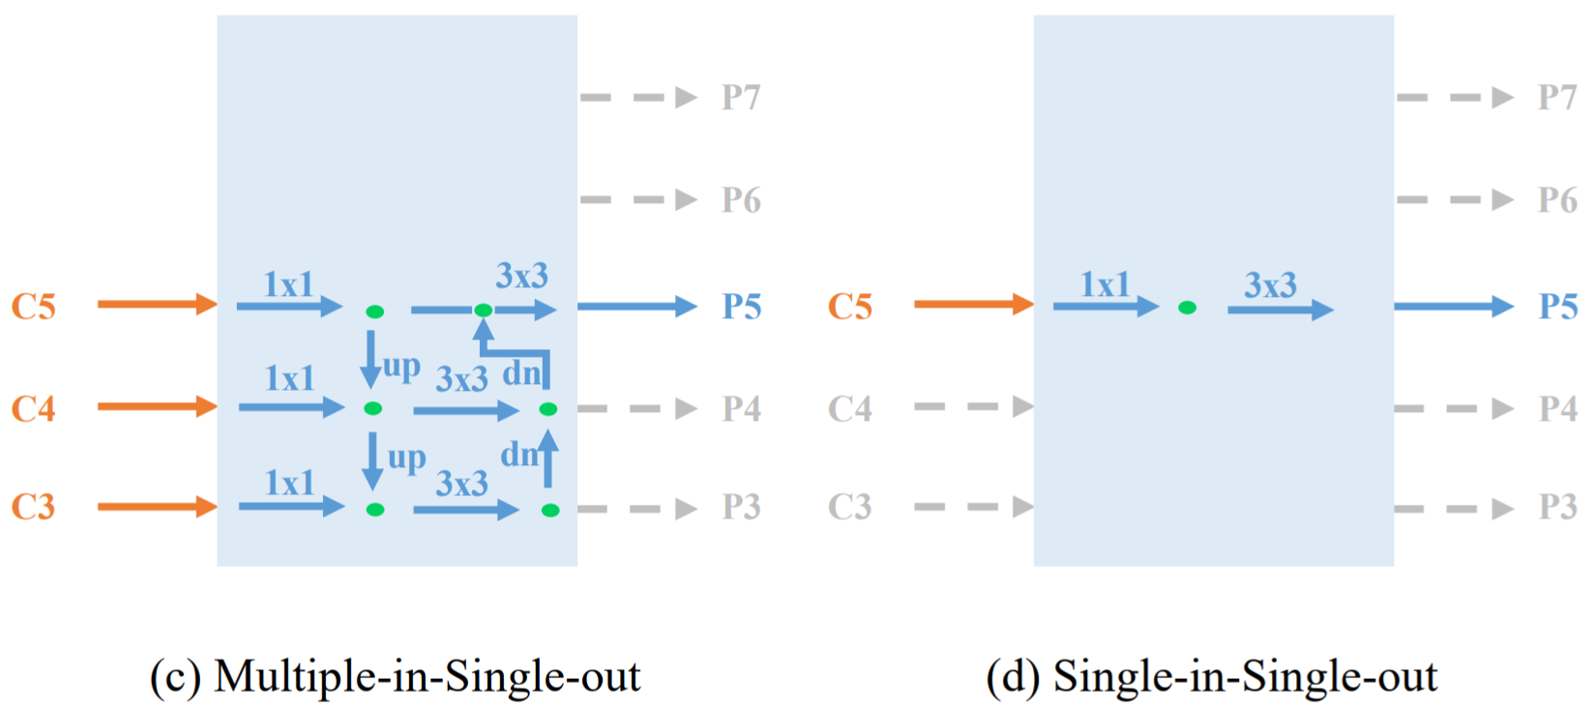
1
Introduction
Contribution
We show that the most signiﬁcant beneﬁts of FPN is its divide-and-conquer solution to the optimization problem in dense object detection rather than the multi-scale feature fusion.

Slide 6
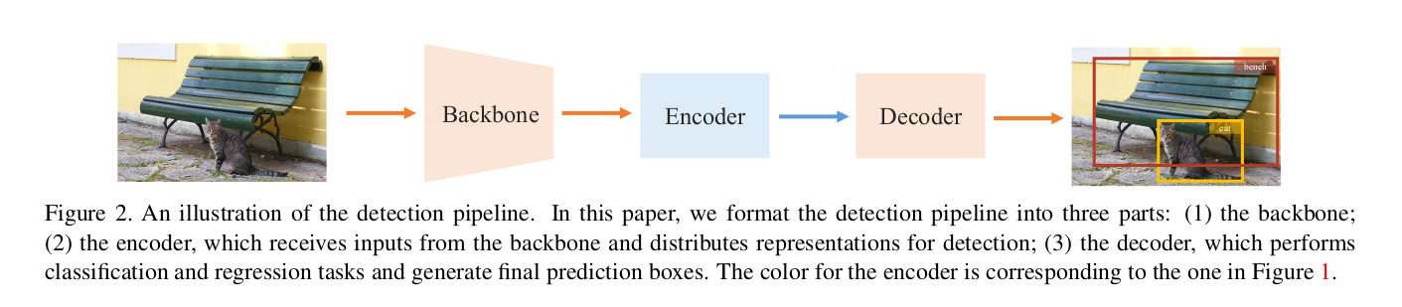
1
Introduction

Slide 7
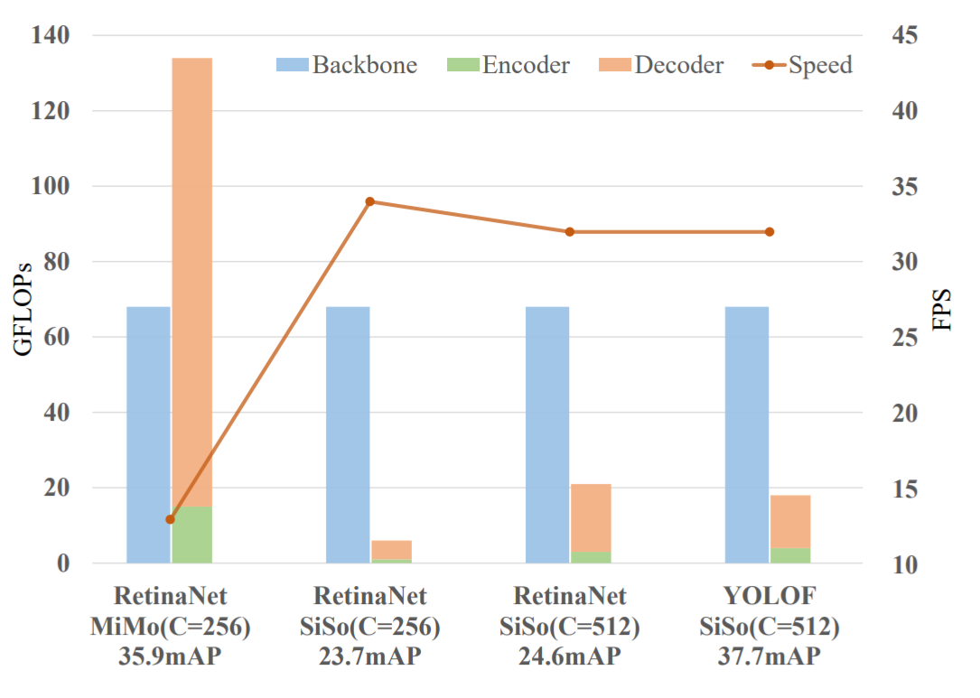
1
Introduction
Compared with SiSo encoders, the MiMo encoder brings enormous memory burdens to the encoder and the decoder(134G vs. 6G) . Moreover, the detector with MiMo encoder runs much slower than the ones with SiSo encoders (13 FPS vs. 34 FPS) .

Slide 8
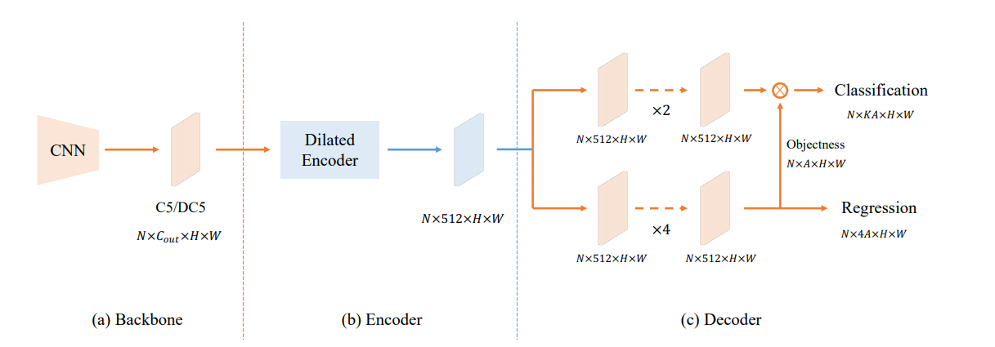
1
Introduction
Contribution
We present YOLOF, which is a simple and efﬁcient baseline without using FPN. In YOLOF, we propose two key components, Dilated Encoder and Uniform
Matching, bridging the performance gap between the SiSo encoder and the MiMo encoder.

Slide 9
2
Method

Slide 10
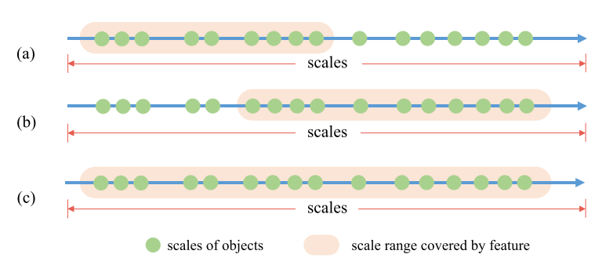
2
Method
Limited Scale Range
The ﬁrst problem is that the range of scales matching to the C5 feature’s receptive ﬁeld is limited, which impedes the detection performance for objects across various scales.

Slide 11
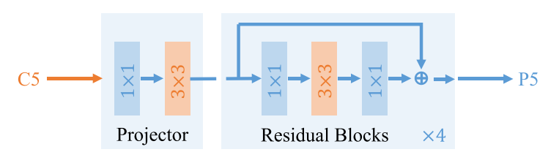
2
Method
Dilated Encoder
It contains two main components: the Projector and the Residual Blocks.
● The projection layer ﬁrst applies one 1 × 1 convolution layer to reduce the channel dimension, then add one 3×3 convolution layer to reﬁne semantic contexts, which is the same as in the FPN.
● we stack four successive dilated residual blocks with different dilation rates in the 3 × 3 convolution layers to generate output features with multiple receptive ﬁelds, covering all objects’ scales.

Slide 12
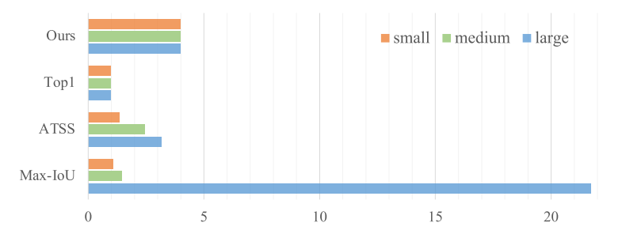
2
Method
Imbalance Problem on Positive Anchors
Large ground-truth boxes induce more positive anchors than small ground-truth boxes in natural, which cause an imbalance problem for positive anchors. This imbalance makes detectors pay attention to large ground-truth boxes while ignoring the small ones when training.

Slide 13
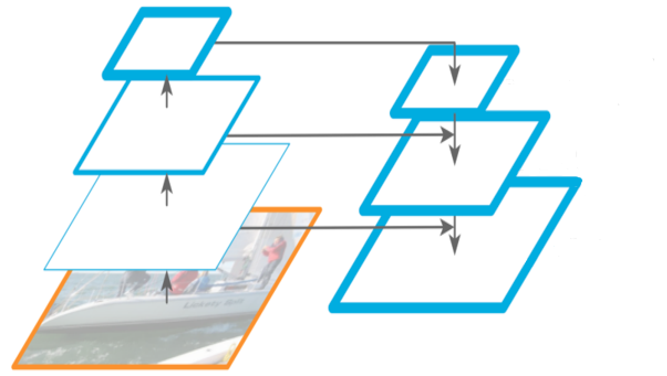
2
Method
Uniform Matching
we propose an Uniform Matching strategy: adopting the k nearest anchor as positive anchors for each ground-truth box, which makes sure that all groundtruth boxes can be matched with the same number of positive anchors uniformly regardless of their sizes

Slide 14
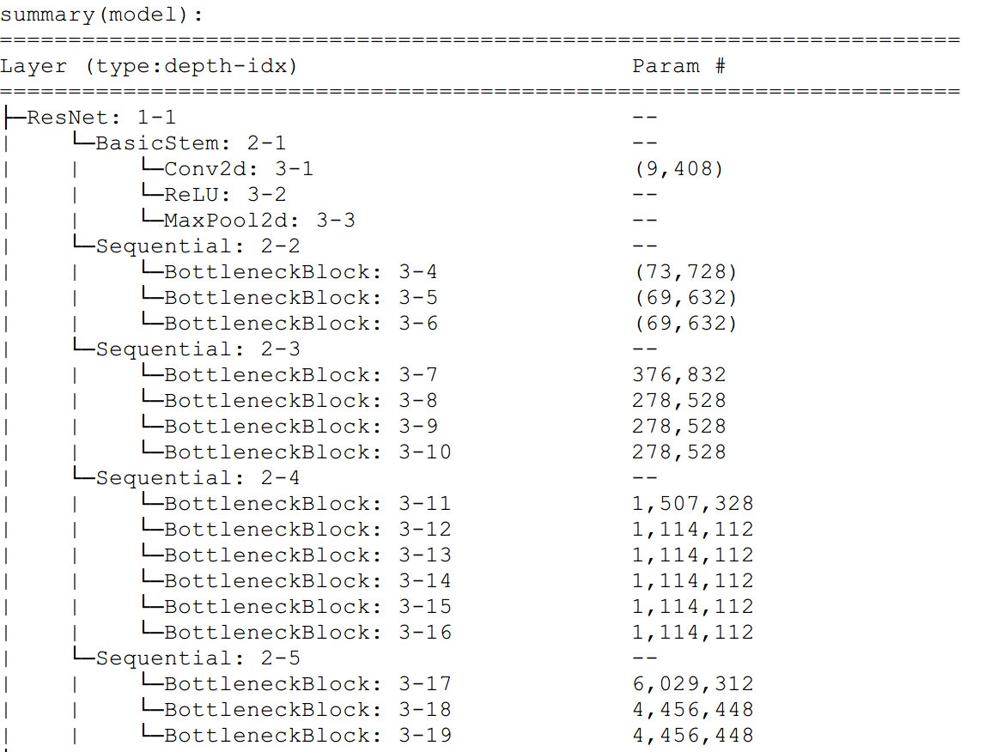
2
Method
Model : backbone

Slide 15
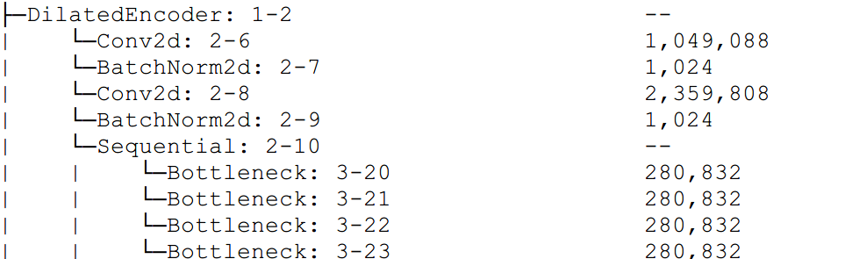
2
Method
Model : Encoder

Slide 16
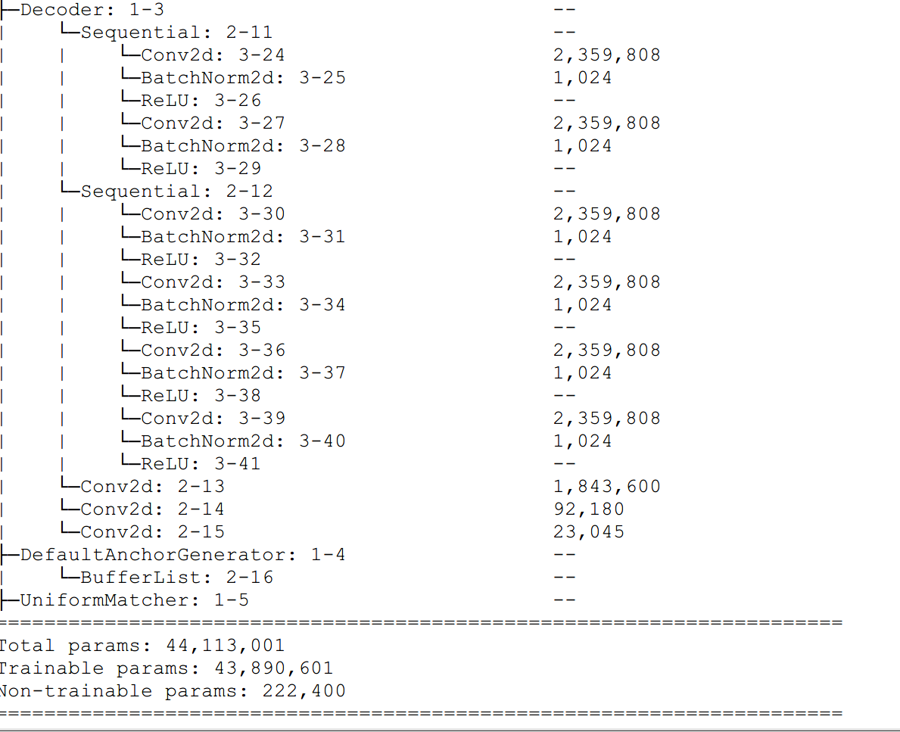
2
Method
Model : Decoder

Slide 17
3
Experiment

Slide 18
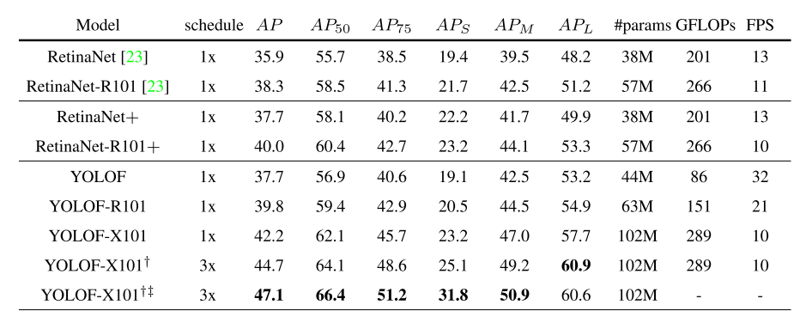
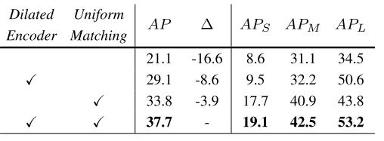
3
Experiment
Table1 Comparison with RetinaNet on the COCO2017 validation set.
Table4 Effect of Dilated Encoder and Uniform Matching with ResNet-50.

Slide 19
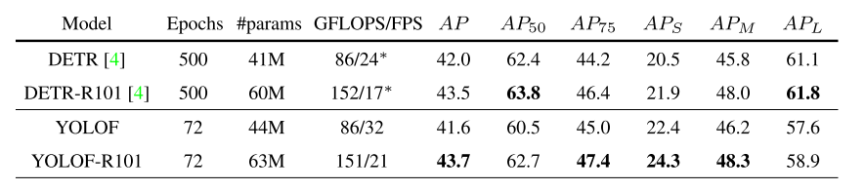
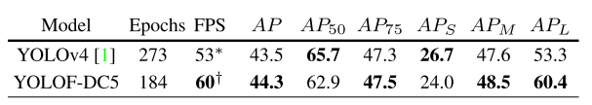
3
Experiment
Table2 Table 2. Comparison with DETR on the COCO2017 validation set.
Table3 Comparison with YOLOv4 on the COCO test-dev set.

Slide 20


